Slide 1

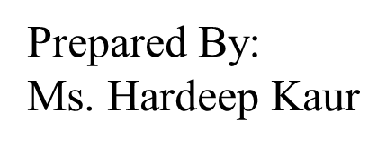
UNIVERSITY INSTITUTE OF ENGINEERING
COMPUTER SCIENCE ENGINEERING
Bachelor of Engineering (Computer Science & Engineering)
Subject Name: STATISTICAL METHODS USING R
Subject Code: 20SMT-460

Slide 2
Introduction to R

Slide 3
Data Structures in R Programming
A data structure is a particular way of organizing data in a computer so that it can be used effectively. The idea is to reduce the space and time complexities of different tasks. Data structures in R programming are tools for holding multiple values.
R’s base data structures are often organized by their dimensionality (1D, 2D, or nD) and whether they’re homogeneous (all elements must be of the identical type) or heterogeneous (the elements are often of various types).

Slide 4
This gives rise to the three data types which are most frequently utilized in data analysis.
The most essential data structures used in R include:
Vectors
Dataframes
Matrices

Slide 5
Vectors
A vector is an ordered collection of basic data types of a given length. The only key thing here is all the elements of a vector must be of the identical data type e.g homogeneous data structures. Vectors are one-dimensional data structures.

Slide 6
Example: # R program to illustrate Vector # Vectors(ordered collection of same data type) X = c(1, 3, 5, 7, 8) # Printing those elements in console print(X)
Output:
[1] 1 3 5 7 8

Slide 7
Dataframes
Dataframes are generic data objects of R which are used to store the tabular data. Dataframes are the foremost popular data objects in R programming because we are comfortable in seeing the data within the tabular form. They are two-dimensional, heterogeneous data structures. These are lists of vectors of equal lengths.
Data frames have the following constraints placed upon them:

Slide 8
A data-frame must have column names and every row should have a unique name.
Each column must have the identical number of items.
Each item in a single column must be of the same data type.
Different columns may have different data types.
To create a data frame we use the data.frame() function.

Slide 9
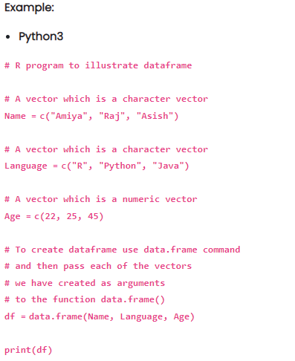

Slide 10
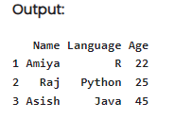

Slide 11
Matrices
A matrix is a rectangular arrangement of numbers in rows and columns. In a matrix, as we know rows are the ones that run horizontally and columns are the ones that run vertically. Matrices are two-dimensional, homogeneous data structures. Now, let’s see how to create a matrix in R. To create a matrix in R you need to use the function called matrix. The arguments to this matrix() are the set of elements in the vector. You have to pass how many numbers of rows and how many numbers of columns you want to have in your matrix and this is the important point you have to remember that by default, matrices are in column-wise order.

Slide 12
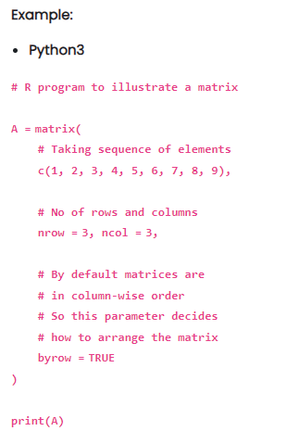

Slide 13
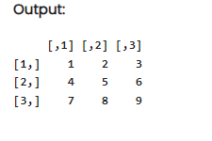

Slide 14
Conclusion:
Understanding how to install R and RStudio, along with grasping basic syntax, data types, and data structures, lays a solid foundation for further exploration of R programming. Practice with examples will enhance your proficiency in using R for data analysis and statistical computing.

